Slide 1
NCI update: drawing connections between TCR features and irAE development
12 12 2023
Ty Bottorff

Slide 2
Outline
irAE introduction
Crossreactive T cell hypothesis
Methods
Preliminary results
Next steps

Slide 3
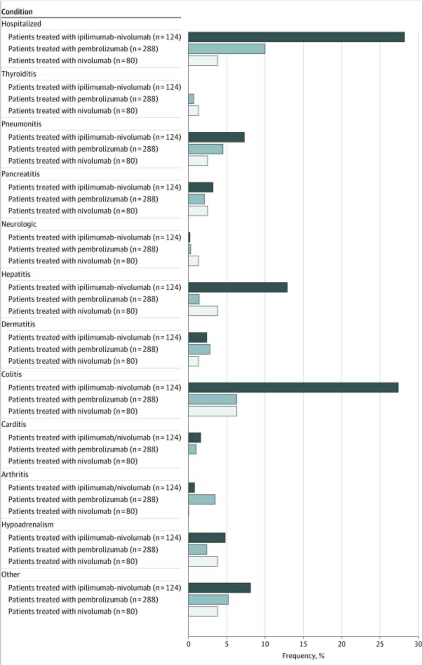
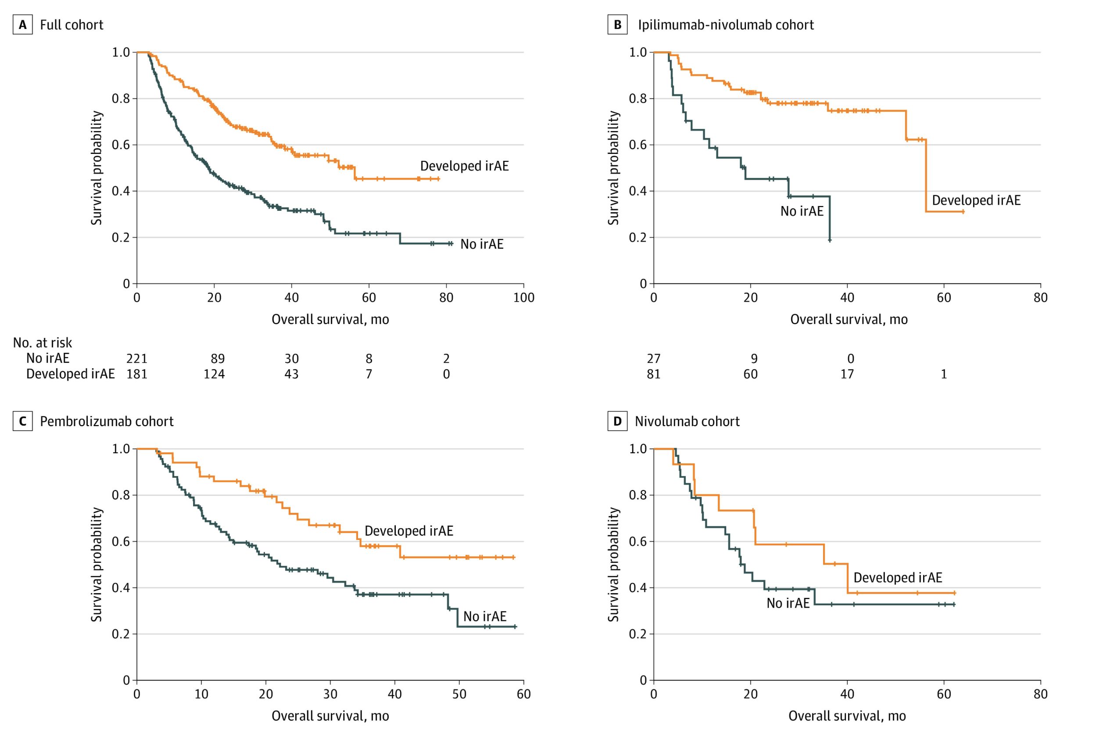
Immune-related adverse events (irAEs) from ICB are common and generally associated with anti-tumor response (PMID31021392, PMID26501224, PMID26446948)
Watson et al. JAMA Netw Open. 2022
Notes:
Ipilimumab: CTLA-4
Pembrolizumab/nivolumab: PD-1
T cell characteristics associated with toxicity to immune checkpoint blockade in patients with melanoma
Autoimmune toxicity occurs in up to 60% of patients treated with immune checkpoint inhibitor (ICI) therapy
Perhaps worth trying to make analogy between viral infections preceeding autoimmunity and tumor response preceeding irAEs?
Association of checkpoint inhibitor-induced toxic effects with shared cancer and tissue antigens in non-small cell lung cancer:
irAEs associated with response to therapy (also can cite Association of vitiligo with tumor response in patients with metastatic melanoma treated with pembrolizumab), also Nivolumab in resected and unresectable metastatic melanoma: characteristics of immune-related adverse events and association with outcomes
Characterization of anti-cancer immune response associated with immune-related adverse events in patients with kidney cancer (meeting abstract)
- more irAEs in ICB responders, not a new finding

Slide 4
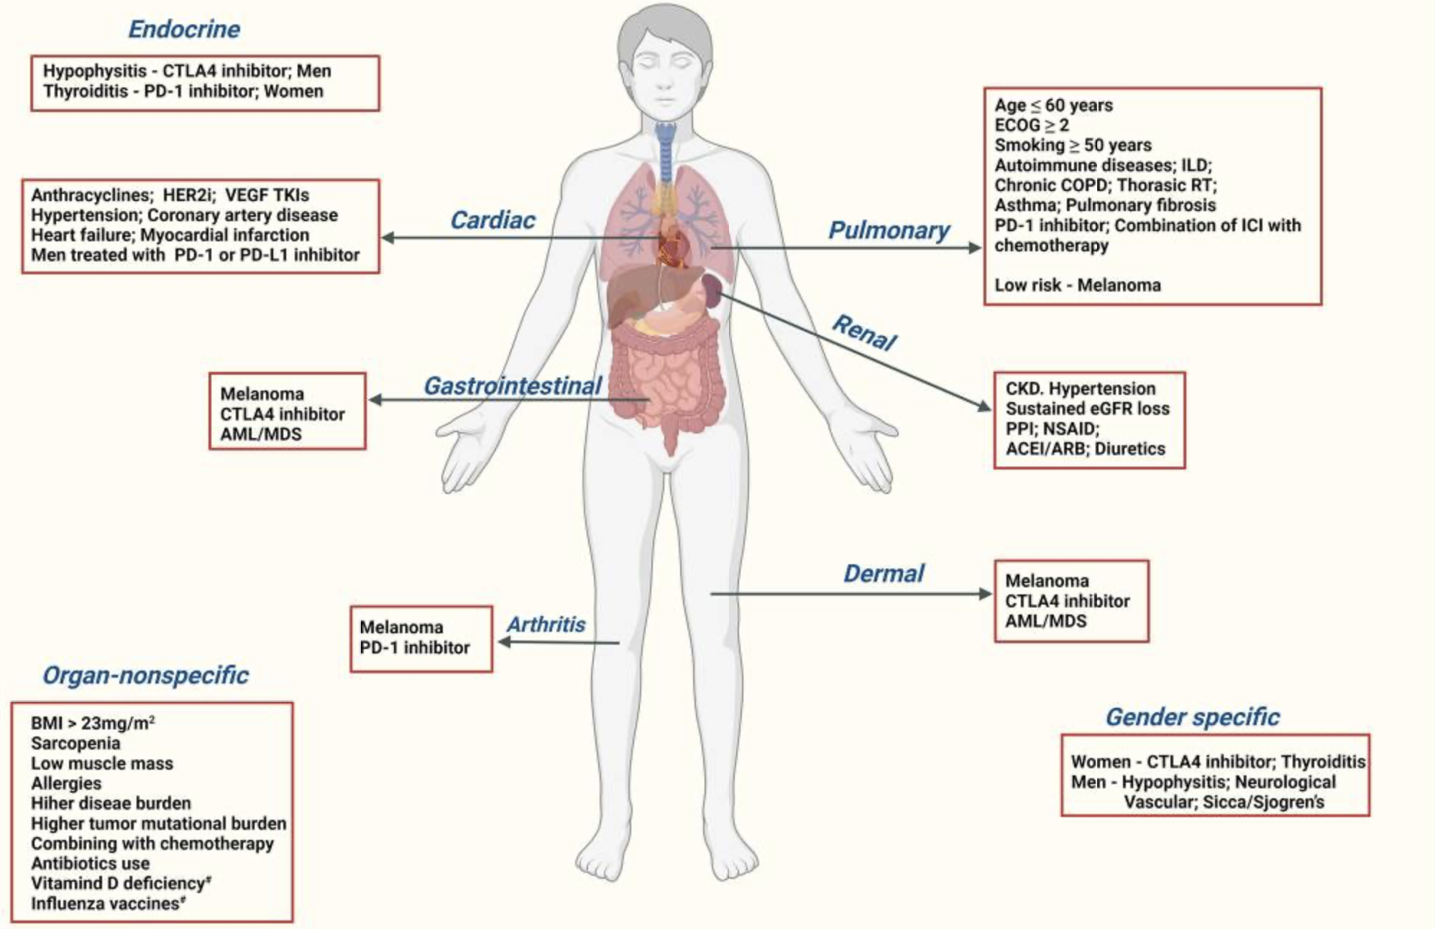
Despite there being many proposed biomarkers for irAE development, there exists a need for more reliable irAE prediction
Chennamadhavuni et al. Front Immunol. 2022
Notes:
Glehr et al. Front Immunol. 2022
unable to reliably predict risk of irAEs in most cases from pre-therapy flow cytometry and clinical data
Germline variants associated with toxicity to immune checkpoint blockade: IL7 cryptic exon, IL7 supports aberrant immune activity in autoimmunity, limits organ toxicity during antiviral immune response, blocks PD-1 leading to T1D (blocking checkpoint when it would have prevented autoimmunity, so IL7 acts as a natural ICB and is therefore rationally associated with irAEs

Slide 5
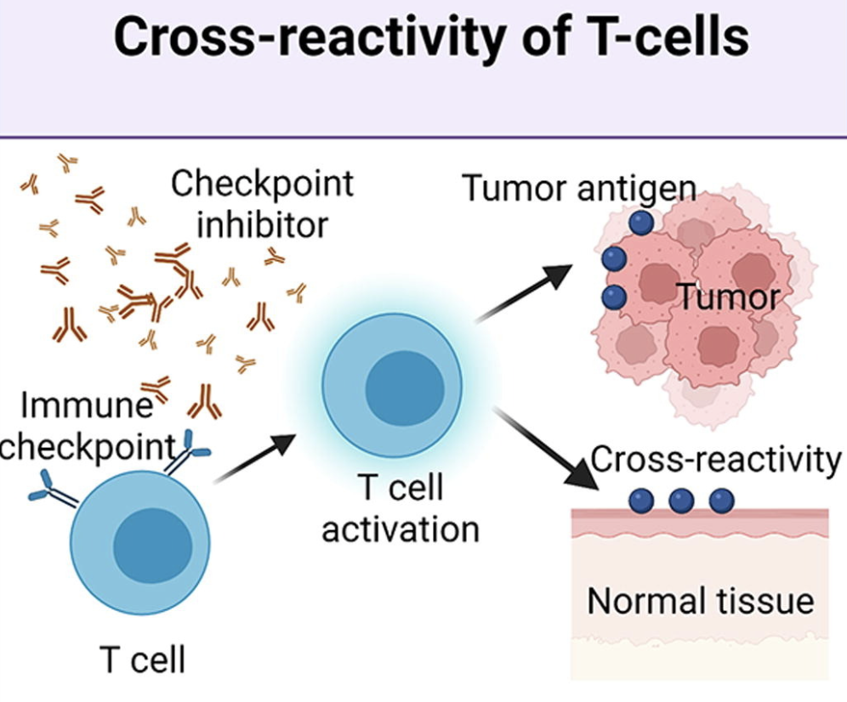
Hypothesis: crossreactive T cells may cause irAEs via reaction to both tumor and self
Supporting evidence
TCRs estimated to potentially react with 1 in ~10k encountered peptides (PMID37409132)
ICB remodels TCR repertoire (PMID28031229)
irAE development associated with T cell expansion (PMID27698113, PMID33597266, PMID33643899)
most similar tissue to tumor often has higher irAE incidence (PMID31021392)
infiltration of T cells in irAE tissue (PMID31021392, PMID35101349)
sharing between TCR clonotypes infiltrating primary tumor and irAEs (PMID31021392, PMID30832716, PMID34589959) and metastases and irAE (PMID37680638)
more peripheral T cell clones shared with TILs in irAE patients (PMID30832716)
Zheng et al. Materials & Design. 2022
Notes:
Hommes et al. Front Oncol. 2021
on treatment markers including clonal expansion of more T cell clones, more newly emerging T cell clones, decline in T cell clonality all associated with more irAEs
Gouttefangeas et al. Front Immunol. 2023
TCR conceivably could recognize ~ 1 million peptides, crossreactive peptides likely often better agonists than original one that activated T cell, but few (~1%) of peptides are actually presented on MHC, so probably crossreactivity estimate closer to 1 in ~10,000
estimate TCRs to be able to bind ~10^5 to 10^6 peptides (Amino acid similarity accounts for T cell crossreactivity and for "holes" in the T cell repertoire)
Berner et al. JAMA Oncology, 2019
skin second most similar to NSCLC after lung and had second highest proportion of irAEs (also Autoreactive napsin A-specific T cells are enriched in lung tumors and inflammatory lung lesions during immune checkpoint blockade)
same T cell clonotypes infiltrated both lung tumor and autoimmune skin lesions
Speculation for what crossreactive T cells are actually targeting, perhaps T cells targeting cancer neoantigens cross-react with WT version of protein in healthy tissue (Autoreactive napsin A-specific T cells are enriched in lung tumors and inflammatory lung lesions during immune checkpoint blockade)
What makes TCRs crossreactive? cross-reactivity need not result from sequence similarity (3D structural similarity more important than 1D sequence similarity (Peter’s paper: Autoreactive T cell receptors with shared germline-like α chains in type 1 diabetes)
Kato et al. Journal of Clinical Oncology, 2023
- some irAE-provoked T cell clones circulate systemically and attack tumor cells leading to ICB response in irAE patients or vice a versa some tumor-provoked T cell clones circulate systemically and attack self leading to irAEs? not sure how they differentiate between the two
Subudhi et al. Proc Natl Acad Sci USA, 2016
CD8 T cell clonal expansion was greater in patients developing severe irAEs
Effective use of latent semantic indexing and computational linguistics in biological and biomedical applications: HLA-B57 restricted T cells are more crossreactive to mutants of target epitopes, this HLA allele also associated with autoimmunity
PMID: 33597266
- expansion of peripheral CD8+ T cell populations specific for melanocyte antigens observed only in patients who responded to anti-PD-1 therapy, so ICI can promote breakdown of tolerance towards tumor-lineage self-antigens
- perhaps in responders with low neoantigen tumors more often will see irAEs given necessity for immune activity against tumor associated antigens shared between tumor and self
Rapisuwon et al., J Immunother Cancer, 2019
identical CD8+ T cell clone found in 4 tissues in a patient with widespread irAEs (duodenum for enteritis irAE, PBMCs, original tumor and liver metastasis responses as well), evidence for crossreactivity underlying irAEs OR common antigen between tumor and self underlying irAEs
duodenitis blocked by antibody to integrin α 4 β 7 (LPAM-1) which blocks T cell infiltraton into GI tract, suggesting that GI toxicity resulted from circulating T cells trafficked to GI tract following expansion elsewhere i.e. in the tumor perhaps
Global analysis of shared T cell specificities in human non-small cell lung cancer enables HLA inference and antigen discovery: autoreactive T cells in peripheral blood may exist (pruned but not clonally deleted thymus) to avoid immunologic "blind spots" to pathogens, i.e. pathogens that look like self would get by free otherwise if we didn't have some autoreactivity perhaps
Heterogeneity of autoreactive CD8+ T cells at sites of inflammation
shared clonal origin among CD8+ T cells at site of colitis with gut Trm cells, suggesting clonal expansion from Trm population being responsible for irAEs (different from autoimmune, so for tissues that lack Trm cells, like the synovium, trafficking of T cells from the periphery may be important for irAEs)
PMID: 35101349
T cells seen infiltrating into irAE tissue, T cells seen targeting irAE tissue seen in blood, so T cells involved in irAEs
autoantibodies present ~50% of time for irAEs
Oh et al. Cancer Res. 2018
CTLA-4 blockade induced greater diversification of T cell repertoire (more clonotypes including newly detected clones, decreased clonality) in irAE patients compared to no irAE patients
Improved survival with T cell clonotype stability after anti-CTLA-4 treatment in cancer patients
diverse repertoires are important in limiting the magnitude of immune escape but may also promote self-reactive clones and induce host inflammation
Carbone et al. Front Immunol. 2023
they usually find different TCR sequences in vitiligo and primary melanoma lesions, so T cell response against normal melanocytes leading to vitiligo is not usually mediated by reactivation of T cell clones infiltrating/specific to primary melanoma but rather perhaps by T cells targeting metastatic tissues, so kind of different from my thinking of usually crossreactivity between primary tumor and irAE site but could also be crossreactivity between metastases and irAE sites
metastasis and vitiligo sample TCRs more similar than primary melanoma and vitiligo TCRs
Interpreting T cell crossreactivity through structure: implications for TCR-based cancer immunotherapy
crossreactivity driven by structural similarities of seemingly unrelated pMHCs (by sequence)
PMID: 34589959
can see same clonotypes of T cells reactive against tumor and self in irAEs
Trm cells locally expanded in irAE-dermatitis and -colitis

Slide 6
Goal: determine if TCR (junction) features can serve a proxy for T cell cross-reactivity
Features to investigate
Junction length (PMID33289628, PMID12152083, PMID9597140), chemical properties (PMID35177831)
TCR germline-ness (probability of generation)
Possible effects of feature variations
Altered TCR-pMHC contact geometry, binding modes, number of contacts
Altered diversity?
Notes:
Initially thought that more germline-like TCRs might be more cross-reactive as they have lower sequence complexity, don’t fully understand that hypothesis though…
Hydrophobicity: more hydrophobic TCRs might be more cross-reactive as they allow more alternative contacts
Entropic contributions and the influence of the hydrophobic environment in promiscuous protein-protein association: interface demonstrates promiscuity in part due to the number of interactions this hydrophobic interface allows, which allows many alternative contacts (increased entropy, drives forward binding) with other binding partners hence promiscuity
Repertoire analyses reveal T cell receptor sequence features that influence T cell fate
TRB CDR3 hydrophobicity promotes reactivity to self-peptides
Functionally specialized human CD4+ T cell subsets express physiochemically distinct TCRs: longer CDR3s might promote crossreactivity
Statistical analysis of CDR3 length distributions for the assessment of T and B cell repertoire biases:
The length of the CDR3 loop greatly influences its shape and ability to fold both on itself and in the company of others loops such as the CDR1 and CDR2

Slide 7
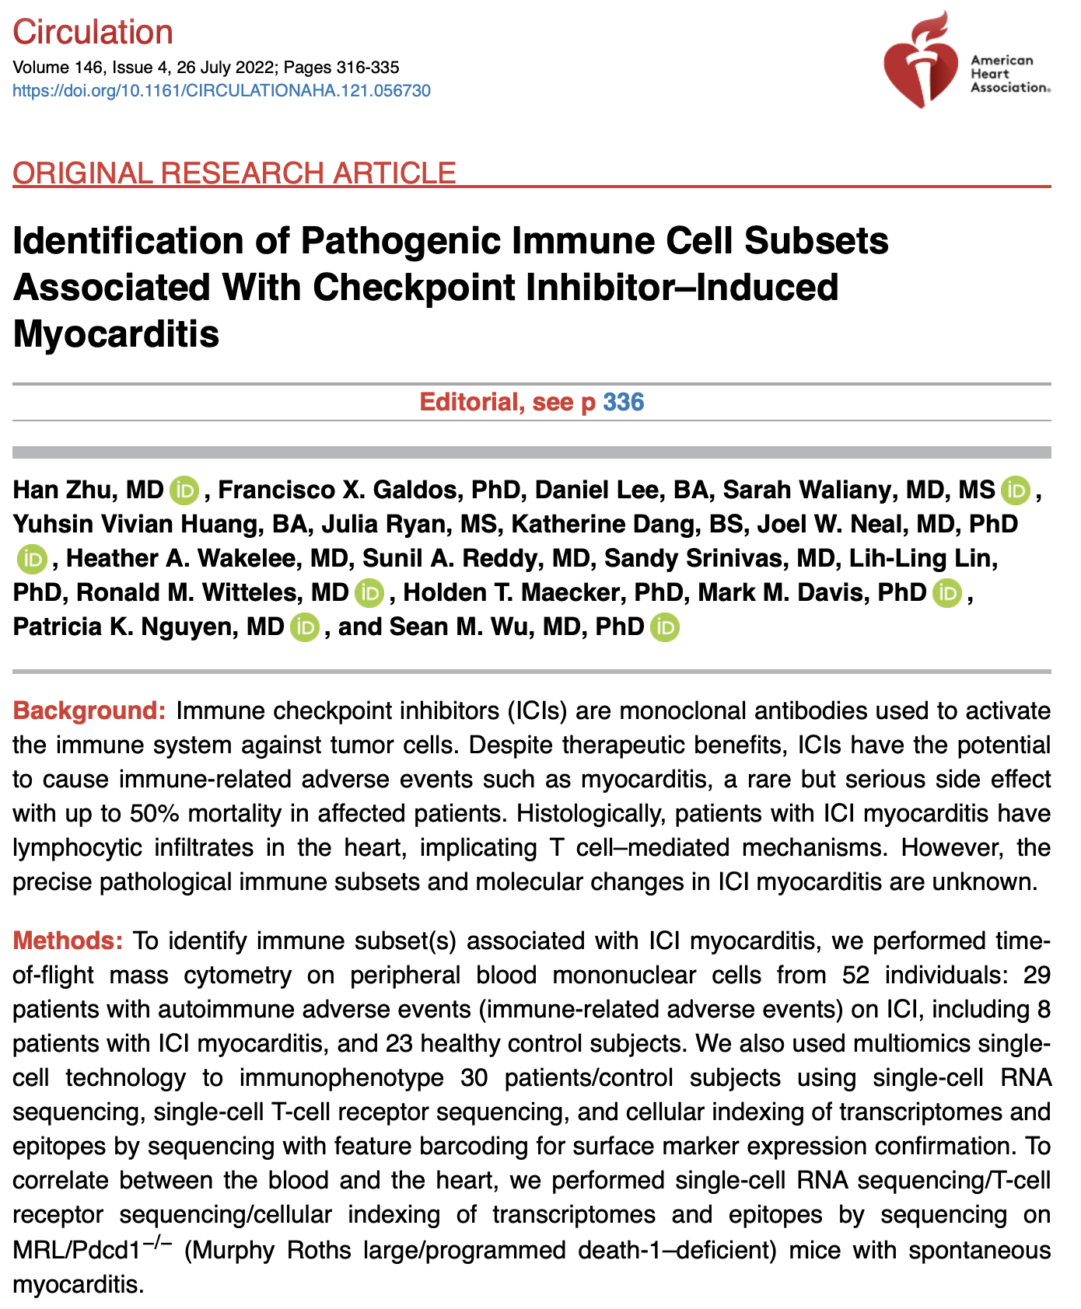
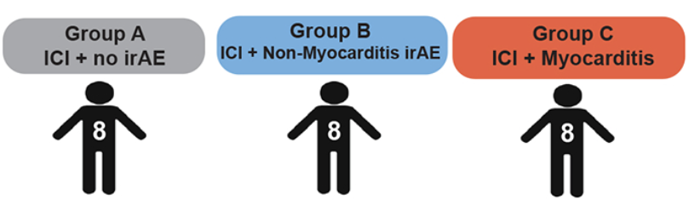
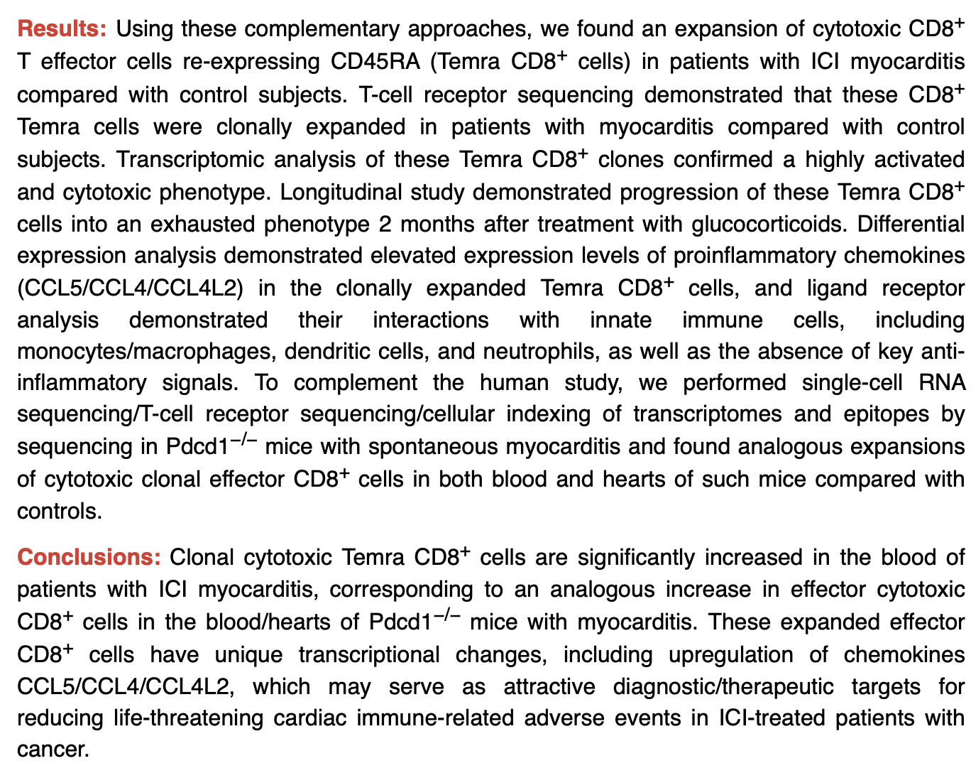
Pooled groups B & C for power
(still observe same trends if not pooled)
Notes:
Stress recency! 2022!

Slide 8
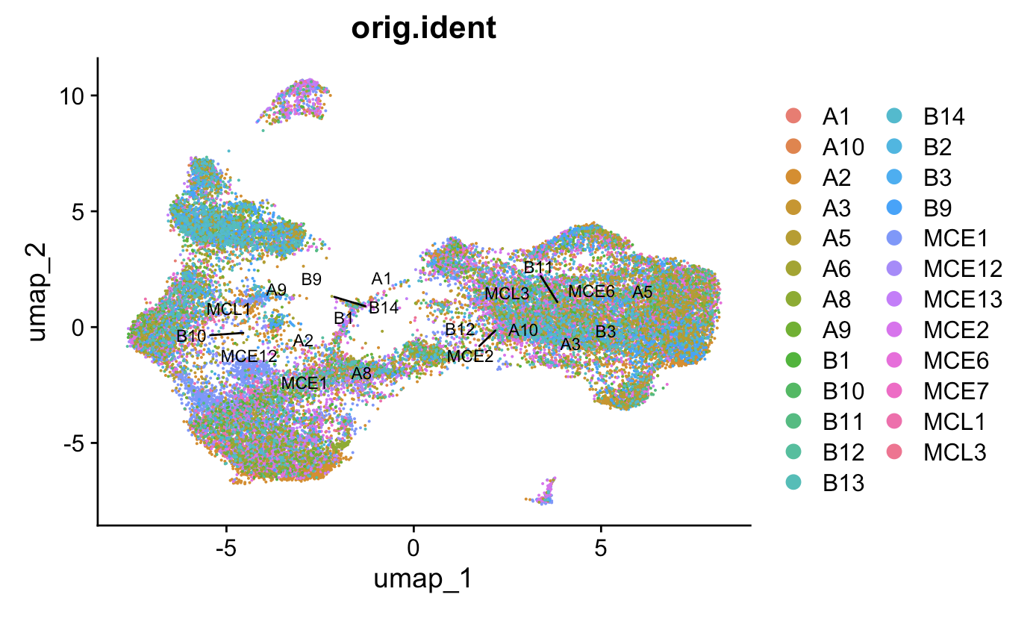
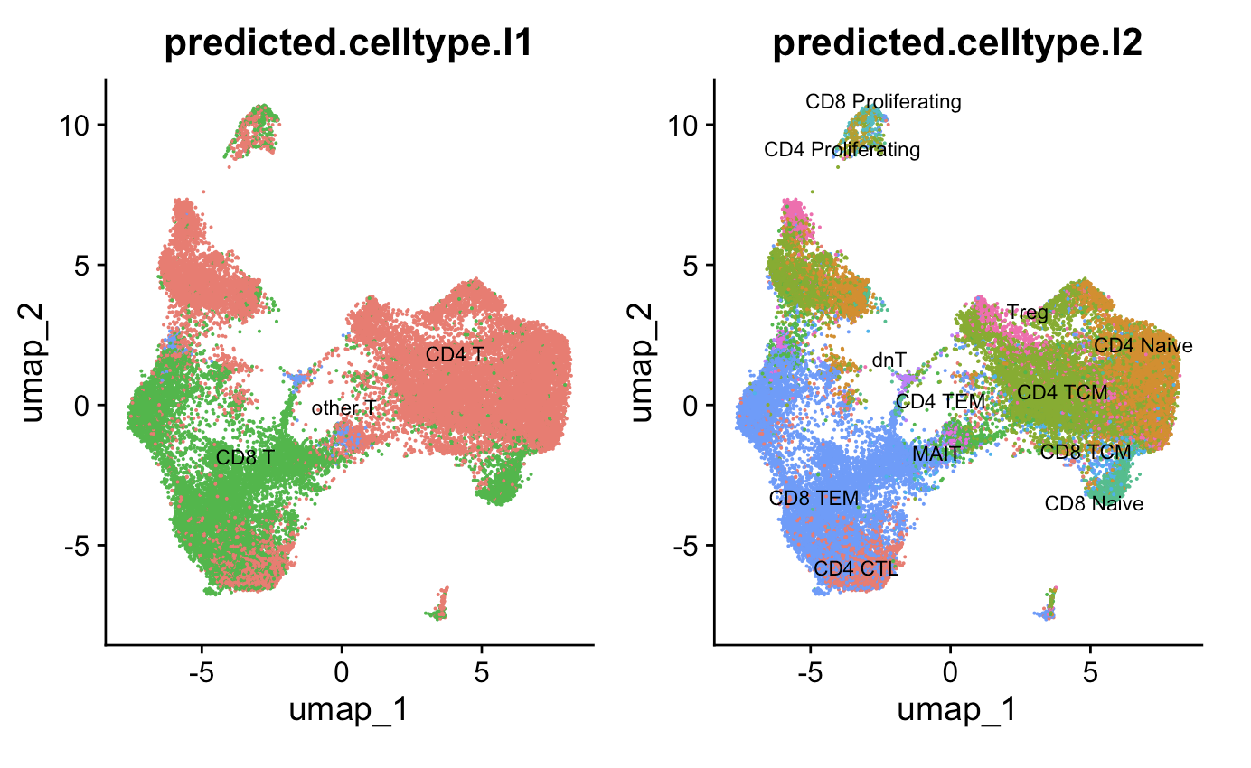
Methods
Patient ID
Quality control, filter out ~50k cells, obtain ~180k cells
Data normalization
Highly variable feature selection
Data scaling
Dimensional reduction
Clustering of cells
Reference map clusters to identify cell (sub)types
Remove non-T cells, repeat steps 5-7, obtain ~30k T cells
Use Stitchr package (PMID35325179) to join full TCR sequences from V(D)JC and CDR3 sequences
Downsample reads per patient → ~4k T cells
CDR3 length and TCR probability of generation (pgen, PMID29422654) analysis
Notes:
Gloss over 1-7
QC/metrics:
Mitochondrial RNA < 15%
> 500 unique RNAs/cell
181,403 cells remain after QC (50,524 cells dropped)
30,136 T cells (before downsample)
328 TCRs/patient (24 patients) downsampling = 7872 total TCRs after downsampling

Slide 9
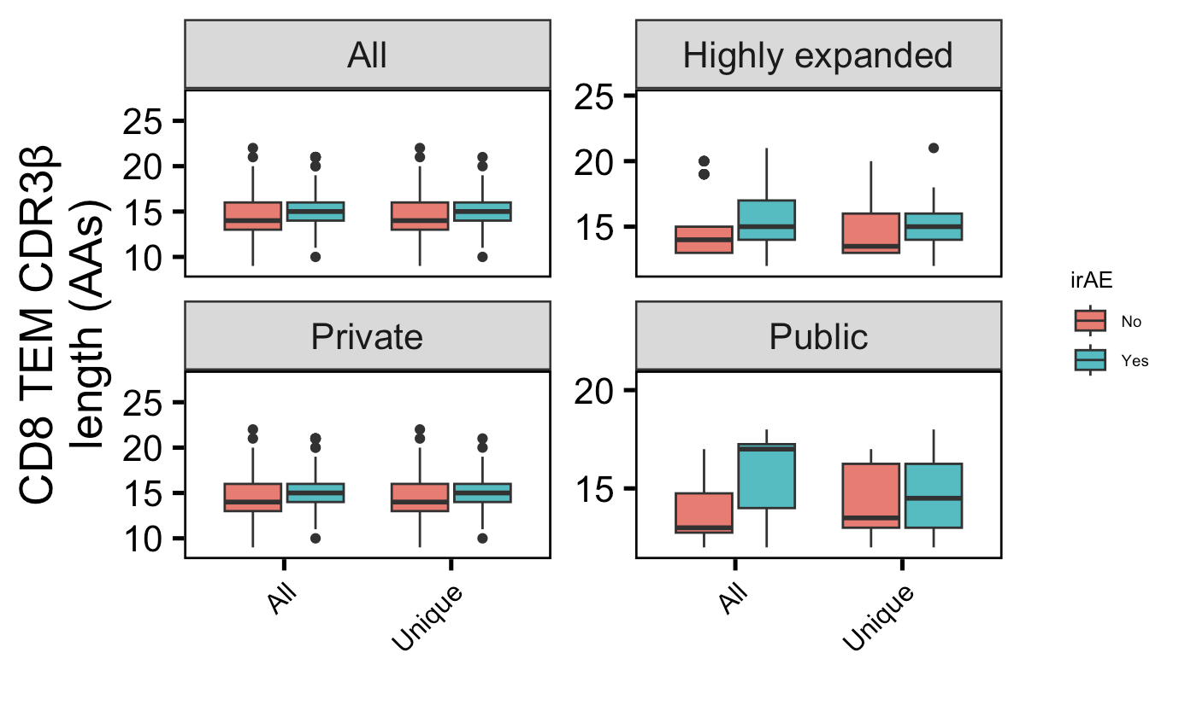
CD8 TEM CDRβs slightly longer in those developing irAEs
n.s.
n.s.
n = 278, 788
188, 350
57, 335
8, 32
n.s.
n.s.
n = 270, 676
182, 335
8, 112
6, 16
Notes:
Downsampled
Saying highly-expanded in title because only see effect with all not with unique (unique takes away effect of expansion)
only a small portion of an antigen is needed to be recognized by a TCR (8-10 amino acids for MHCI, 14-18 for MHCII, does this mean that CD8+ T cells might be more cross-reactive?)
T cell repertoire analysis and metrics of diversity and clonality
CDR1-2 contact MHC and CDR3 contacts peptide is the general rule, but CDR1α also contacts peptide and CDR3β doesn't contact peptide too much
Public refers to clonotype not (CD8 T) cell

Slide 10
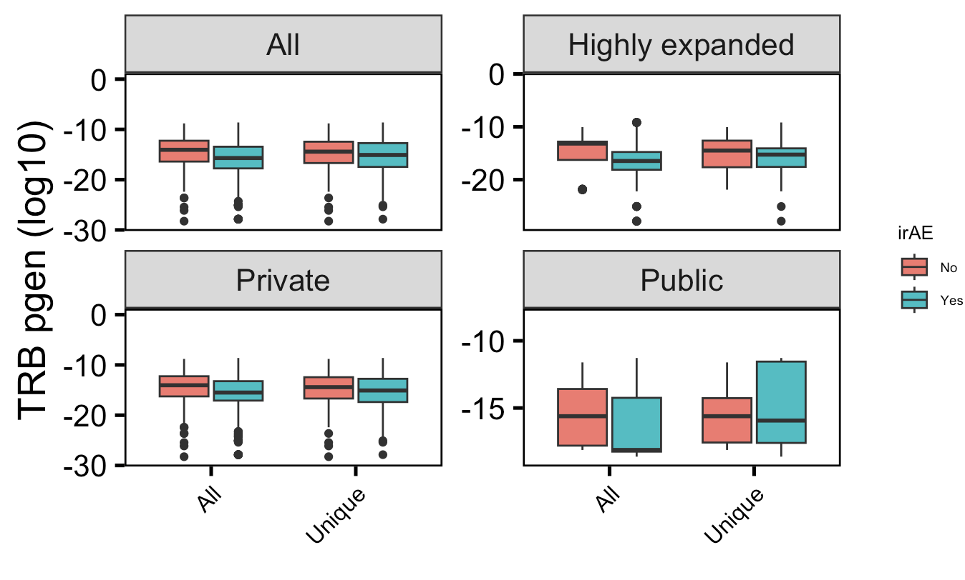
CD8 TEM TRBs slightly less germline-like in those developing irAEs
n.s.
n.s.
→
More germline-like
n = 278, 788
188, 350
57, 335
8, 32
Less germline-like
n.s.
n.s.
→
n = 270, 676
182, 335
8, 112
6, 16
Wilcoxon rank sum test. ****, padj <1e-4; **, padj <1e-2; *; padj <0.05
Notes:
Downsampled
Saying highly-expanded in title because only see effect with all not with unique (unique takes away effect of expansion)
Higher pgen generally means that it's closer to germline because the probability of mutation is lower than not mutation
Public refers to clonotype not (CD8 T) cell

Slide 11
Conclusions
Slightly longer CDR3B CD8 TEMs and less germline-like CD8 TEM TRBs in those developing irAEs, but no significant differences when comparing unique TCRs
We can mine public data and use it in tandem with BRI data, for example using one as a training set and the other as a test set
Increased confidence in conclusions that are recapitulated across multiple datasets
Increased breadth of possible research questions to investigate
Notes:
Identification of neoantigens for individualized cancer immunotherapy
cross-reactivity is possible due to low affinity of functional TCR-pMHC interaction
Lack of necessity for super high affinity TCR-pMHC may support more alternative contacts ~= more crossreactive hypothesis (i.e. longer CDR3 may disrupt peak affinity but may allow more possible ok TCR-pMHC interactions sufficient to induce T cell activation)
Context of BRI/VDJdb data…
Public/shorter CD8 TRAs/higher pgen expected more crossreactive from BRI/VDJdb data... (VDJdb not pgen, BRI all 3)

Slide 12
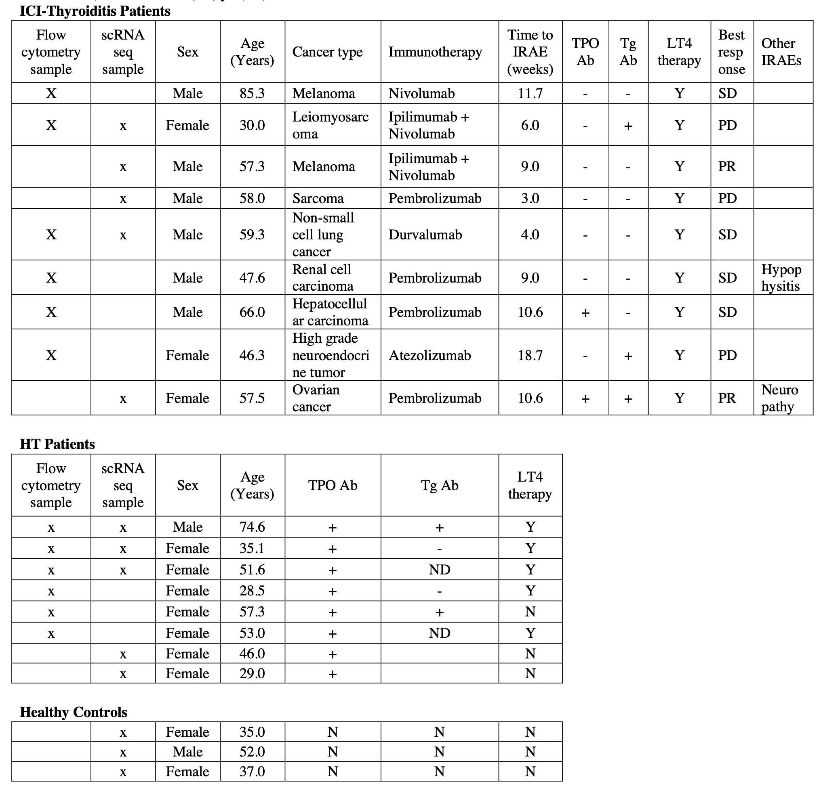
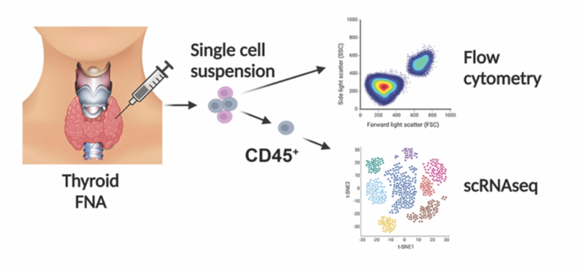
Next steps
Especially given differences from BRI data conclusions, want to see if findings from this dataset are recapitulated in another dataset (PMID37196065)
Notes:
Verbally share preliminary data on DEGs (no difference in top/bot) but only if confident
Context of BRI/VDJdb data…
Public/shorter CD8 TRAs/higher pgen expected more crossreactive from BRI/VDJdb data... (VDJdb not pgen, BRI all 3)

Slide 13
Acknowledgements
Peter Linsley
Bioinformatics group
Erin Witkop
Alex Hu
Thomas Edwards
Matt Lawrence
Matt Dufort
Hannah DeBerg

Slide 14
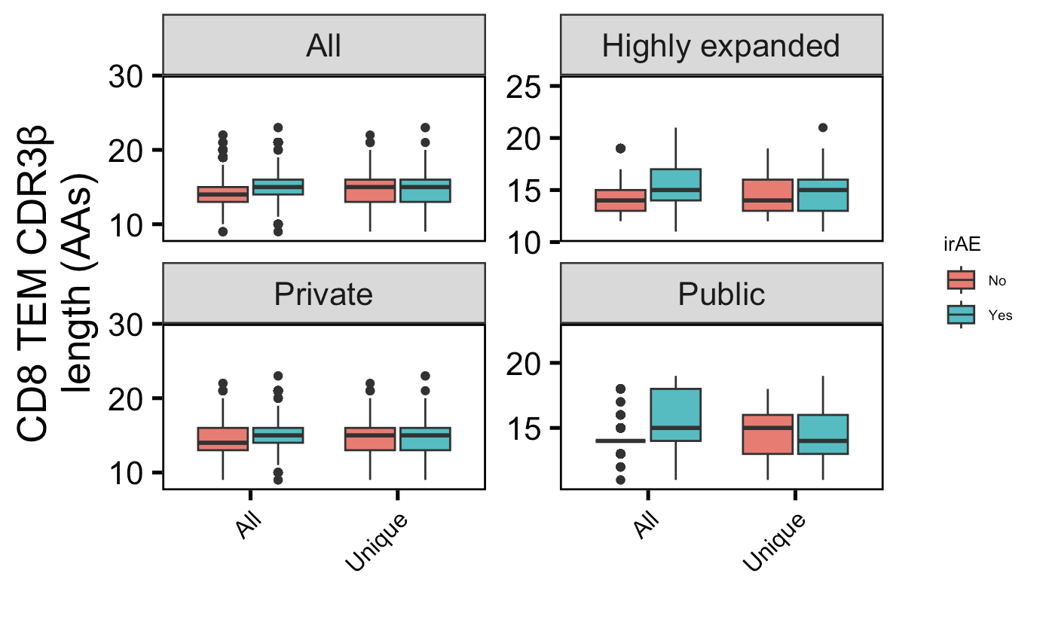
CD8 TEM CDRβs slightly longer in those developing irAEs
n.s.
n.s.
n = 3764, 6291
1265, 1420
1780, 3683
25, 56
n.s.
n.s.
n = 3014, 4106
1205, 1339
750, 2185
61, 88
Wilcoxon rank sum test. ****, padj <1e-4; **, padj <1e-2; *; padj <0.05
Notes:
NOT Downsampled
only a small portion of an antigen is needed to be recognized by a TCR (8-10 amino acids for MHCI, 14-18 for MHCII, does this mean that CD8+ T cells might be more cross-reactive?)
T cell repertoire analysis and metrics of diversity and clonality
CDR1-2 contact MHC and CDR3 contacts peptide is the general rule, but CDR1α also contacts peptide and CDR3β doesn't contact peptide too much
Public refers to clonotype not (CD8 T) cell

Slide 15
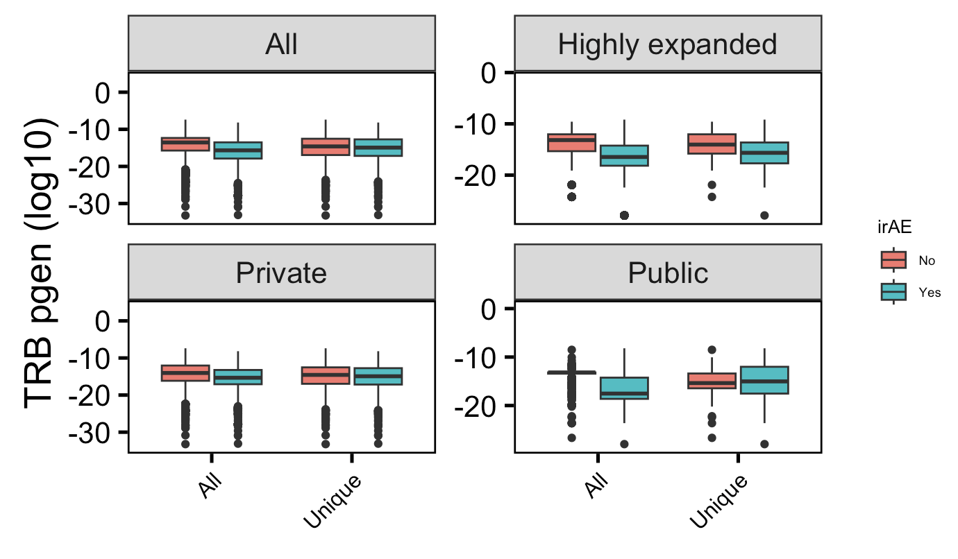
CD8 TEM TRBs slightly less germline-like in those developing irAEs
n.s.
n.s.
→
More germline-like
n = 3764, 6291
1265, 1420
1780, 3683
25, 56
Less germline-like
n.s.
n.s.
→
n = 3014, 4106
1205, 1339
750, 2185
61, 88
Wilcoxon rank sum test. ****, padj <1e-4; **, padj <1e-2; *; padj <0.05
Notes:
NOT Downsampled
Higher pgen generally means that it's closer to germline because the probability of mutation is lower than not mutation
Public refers to clonotype not (CD8 T) cell

Slide 16
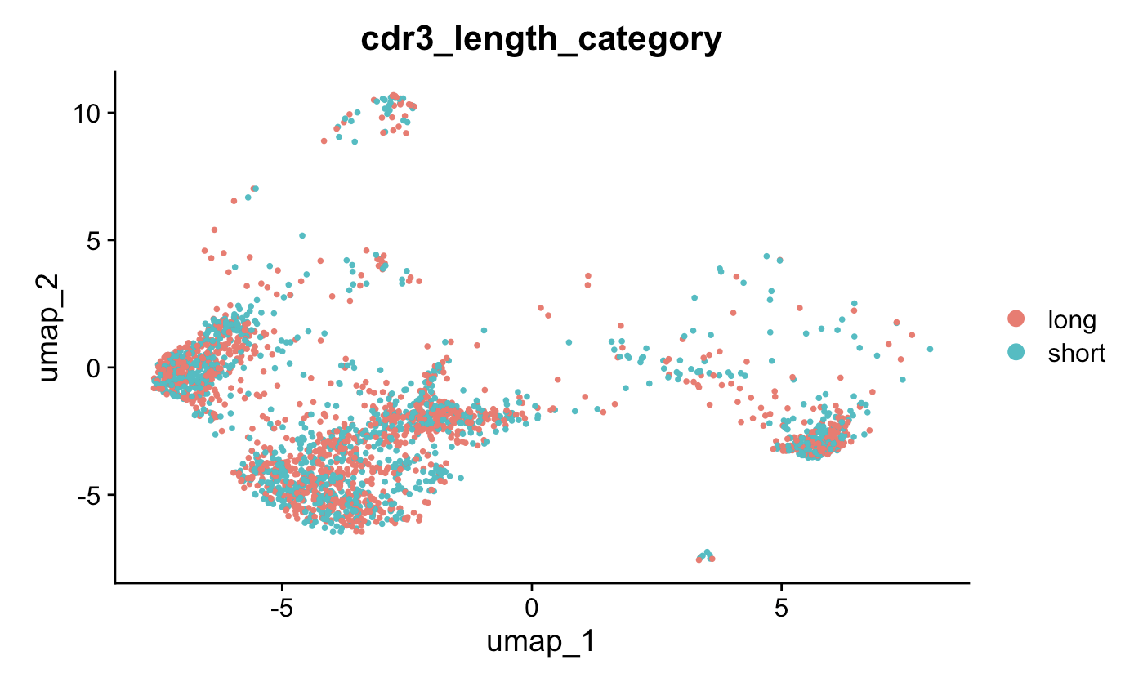
RNA phenotype of cells with longest and shortest TRB CDR3s likely very similar

Slide 17
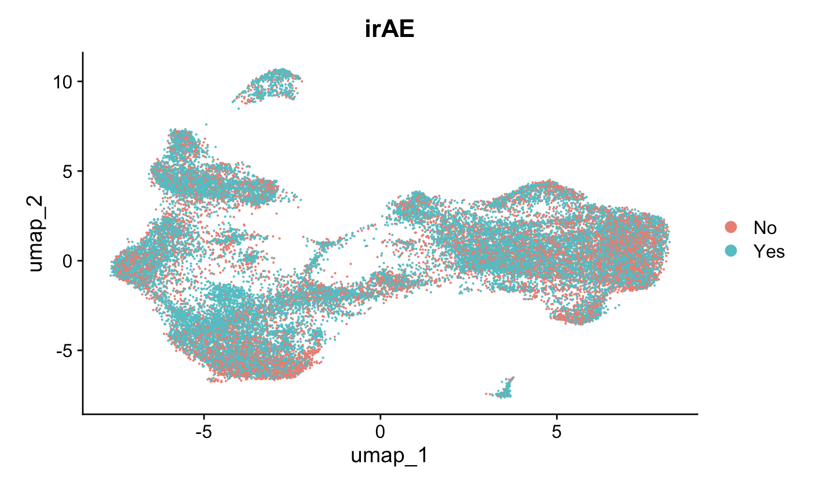
No discernible conclusions from irAE development overlayed onto T cell UMAP
Notes:
just tells of celltype abundance vs irae propensity?

